Slide 1
Lecture 3. Bluetooth Communications (07/05)
1. Bluetooth Communications. 802.15 | a. 802.11 B Wireless Positioning c. Bluetooth working group history d. Applications
2. Technical Overview | a. Principles of SS modulation b. Bluetooth radio link c. Bluetooth Architecture d. Radio connection
3. EM Spectrum | a. Unlicensed Radio Spectrumb. b. Radio propagation: path loss
4. General model of FHSS modulation | a. FHSS b. Fading and multipath
5. Bluetooth Radio | a. Piconet formation b. Bluetooth Physical link c. Scatternet d. Piconet channels e. Multiple Access Scheme
6. The Modulation Scheme
7. Medium Access Control
8. Voice and Data Links
9. Communication Scenario 10. Bluetooth Experiment Goals 11. Materials for HW and the Report | a. Connection Establishment b. Power Management

Slide 2
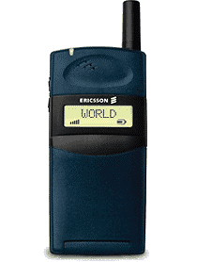


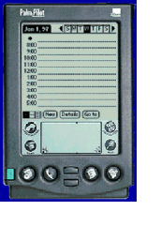
1. Bluetooth Communications. 802.15
Bluetooth is considered as a secure short-range wireless network.
A cable replacement technology
1 Mb/s symbol rate
Range 10+ meters
Single chip radio at low power & low price ($5)
Why not use Wireless LANs?
- power
- cost
No Another wireless LAN

Slide 3

a. 802.11
Replacement for Ethernet
Supported data rates
  11, 5.5, 2, 1 Mbps; and recently up to >20 Mbps in 2.4 GHz
  up to 54 Mbps in 5.7 GHz band (802.11 a)
Range
  Indoor 20 - 25 meters
  Outdoor: 50 – 100 meters
Transmit power up to 100 mW
Cost:
  Chipsets $ 35 – 50
  AP $200 - $1000

Slide 4
b. Wireless Positioning
a) Cellular radio systems;
b) Bluetooth systems;
c) Ad hoc systems.
AP
b)
a)
MSO
c)
AP

Slide 5
Wireless Positioning (cont)
Wireless LAN
On-campus:
Office, School, Airport, Hotel, Home
Cellular
Off-Campus:
Global Coverage
Bluetooth
Person Space:
Office, Room, Briefcase, Pocket, Car
Short Range/Low Power
Voice and Data
Low-cost
Small form factor,
Many Co-located Notes
Universal Bridge

Slide 6
c. Bluetooth working group history
February 1998: The Bluetooth Special Interest Group promoter: Ericsson, IBM, Intel, Nokia, Toshiba.
May 1998:
July 1999: version 1.0A is released.
December 1999: version 1.0B is released.
March 2001: version 1.1 is released
Where Did the Name Come From?
Herald Blatant “Bluetooth II ”–King of Denmark 940-981 AC.
Noted for unifying Denmark and Sweden.

Slide 7
Bluetooth Profiles
Generic Access
Service Discovery
Cordless Telephone
Intercom
Serial Port
Headset
Dial-up Networking
Fax
LAN Access
Generic Object Exchange
Object Push
File Transfer
Synchronization
Applications
User benefits
Multiple device access (phone, music)
Cordless phone benefits
Hands free operation
Conference Table
Cordless Computer
Business Card Exchange
Instant Postcard
Computer Speakerphone

Slide 8
2. Technical Overview

Slide 9
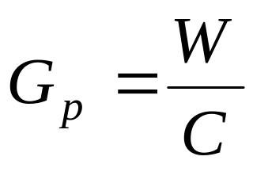
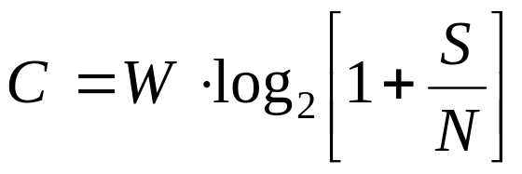
a. Principles of SS modulation
The most important parameter in any SS system is
the processing gain Gp:
This value measures the ratio of:
Transmitted RF bandwidth W
to the narrowband information rate C.
A system with a low signal-to-noise ratio must have a high
processing gain Gp in order to recover the original signal.
Types of Spread Spectrum Modulation:
Direct Sequence Spread Spectrum (DSSS)
Frequency Hopping Spread Spectrum (FHSS)

Slide 10
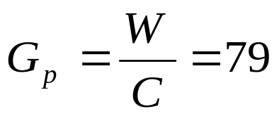
b. Bluetooth radio link
1MHz
. . .
1
2
3
79
83.5 MHz
frequency hopping spread spectrum
  2.402 GHz + k x1MHz, k=0, …, 78=79
  1,600 hops per second (1:1600=625 μs= Dwell time
GFSK modulation - 1 Mb/s symbol rate
Transmit power - 0 dBm (up to 20dBm with power control)
FHSS/TDD channel applied in Bluetooth.
Multiple Ad hoc links will make use of different hopping channels with different hopping sequences and have misaligned slot timing

Slide 11
c. Bluetooth Architecture, Piconets and Scatternets
A Piconet is collection of devices connected to the Master.
One unit will act as a Master (the device, which initiates an exchange of data) and the others as Slaves (the device, which responds to the Master)
Master sets the clock, dwell time, hopping pattern.
Each piconet has a unique hopping pattern/ID
Each master can connect to 7 active (specification limits) or 255 inactive (parked) slaves per piconet
A Scatternet is collection of the Piconets connected in an Ad-Hoc fashion.
Sb
S
M
P
S
P
S
M=Master; S=Slave; P=Parked; Sb=Standby

Slide 12
b. Bluetooth Physical link
Point-to-point link
  master - slave relationship
m
s
  Fast frequency hopping 1600 hops/sec
Piconet
Each Piconet has max capacity
  = 1 Mbps
m
s
s
s
All devices in a Piconet hop together. To form Piconet: master gives slaves its clock and device ID; Hopping pattern (48-bit); determined by device ID; Hopping pattern determined by Clock.
A Piconet is centralized TDD system, with the master controlling the clock and determined which device gets to communicate in which time slot.
The baseband part of the Bluetooth specification describes an algorithm which can calculate a frequency hop sequence from a Bluetooth device address and a Bluetooth clock.

Slide 13
Bluetooth protocol stack
Application layer
Applications
Middleware layer
IP
SDP
RFCOMM
Data
HCI
Data link layer
Audio
L2CAP
Link Manager
Single chip with
RS-232,USB, or
PC card interface
Baseband
Physical layer
RF
The Bluetooth protocol stack is a series of layers, there are some features which cross several layers.

Slide 14
a. Piconet formation
Page - scan protocol
  to establish links with nodes in proximity
Master
Active Slave
Parked Slave
Standby
Direct, slave-to-slave communication is not possible.
Piconet Addressing:
Active Member Address (AMA, 3-bits);
Parked Members Address (PMA, 8-bits)

Slide 15
d. Radio connection
Noise, interference
power
Data signal x(t)
spectrum
Recovered
data signal
cost
Goal:
high bandwidth
conserve battery power
cost < $10

Slide 16
3. EM Spectrum
Industrial, Science, Medicine = ISM band
ISM band
902 – 928 MHz
2.4 – 2.4835 GHz
S/W radio
FM radio
TV
AM radio
TV
cellular
5.725 – 5.785 GHz
LF
MF
HF
VHF
UHF
SHF
EHF
30kHz
300kHz
3MHz
30MHz
300MHz
3GHz
30GHz
300GHz
ν
10cm
100mm
λ
10km
1km
100m
10m
1m
1cm
ISM band
X rays
ν
infrared
visible
UV
Gamma rays
1 kHz
1 MHz
1 GHz
1 THz
1 PHz
1 EHz

Slide 17
a. Unlicensed Radio Spectrum
λ=
33cm
12cm
5cm
26 Mhz
83.5 Mhz
125 Mhz
902 Mhz
2.4 Ghz
5.725 Ghz
928 Mhz
2.4835 Ghz
5.785 Ghz
cordless phones,
baby monitors,
Wireless LANs
802.11 Cell.
802.15 Bluetooth,
Microwave oven
802.11a
HyperLan

Slide 18
b. Radio propagation: path loss
near field
path loss in 2.4 Ghz band
P_{r}
r ≤ 8m
r > 8m
P_{t}
near field
far field
r
∝
r²
∝
r^{3.3}
P_{r}
path loss = 10 log (4πr²/λ) r ≤ 8m
= 58.3 + 10 log (r^{3.3} /8) r > 8m

Slide 19
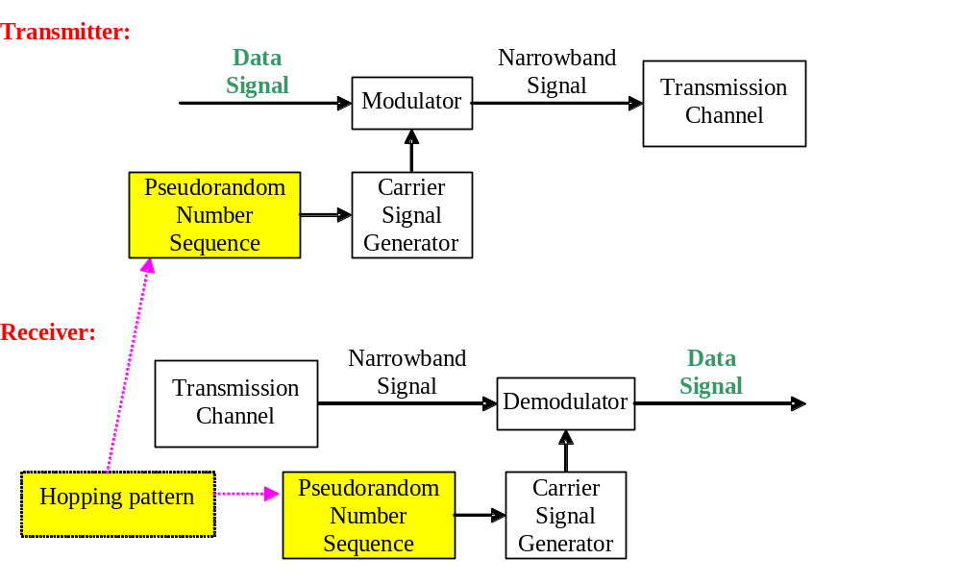
4. General model of FHSS modulation
“chipping”.

Slide 20
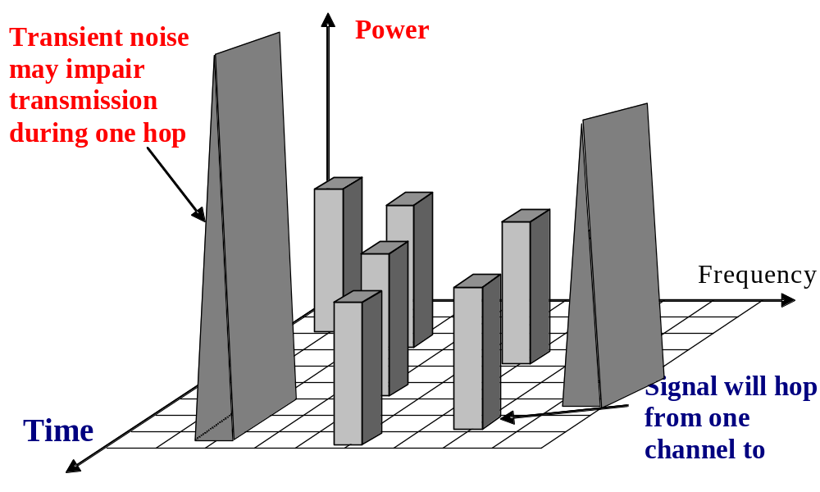
a. FHSS
4
1
2
3
FHSS is an ideal for a WLAN in a noisy frequency band !
4
During any one hop, the signal is vulnerable to noise in that frequency band, but it will soon move to another frequency with less noise. This new band will be sufficiently removed from the previous noisy band

Slide 21
b. Fading and multipath
Fading: rapid fluctuation of the amplitude of a radio signal over a
short period of time or travel distance
Tx
Rx
Effects of multipath

Slide 22
5. Bluetooth Radio
Low Power, Low Cost
  Standby modes wake up durations:
  Sniff, 10 ms
  Hold, <1%
  Park. <<1%
Power Class | Transmit Power | Nominal Range
1 | 100 mW (20 dBm) | 100 m
2 | 2.5 mW ( 4 dBm) | 20 m
3 | 1 m W ( 0 dBm) | 10 m

Slide 23
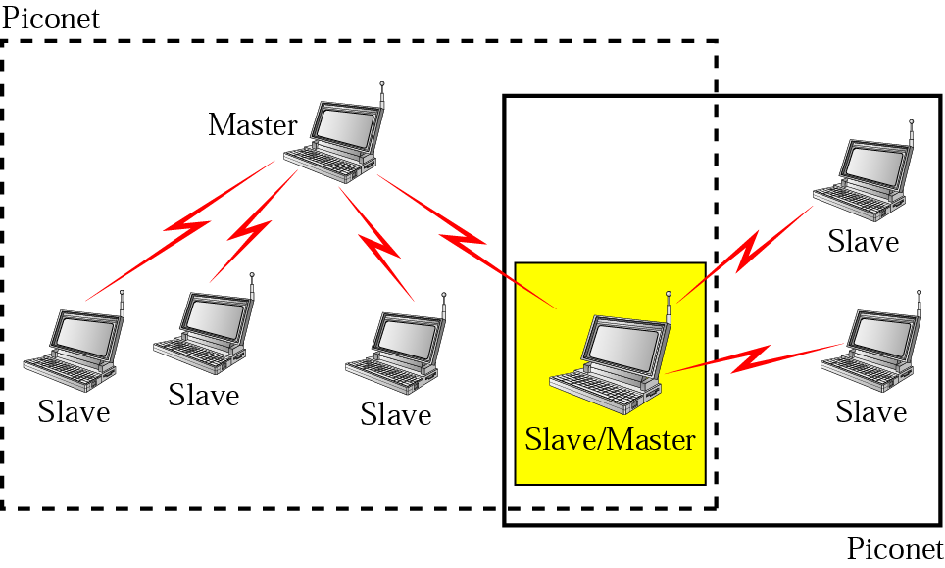
c. Scatternet

Slide 24
Scatternet (cont)
If there are many independent piconets: there could be a collision on a particular channel, these packets will be lost and retransmitted, or if voice signals, it will be ignored.
Master node
Slave node
Bridge node

Slide 25
d. Characteristics
Operates in the 2.4 GHz band at a data rate of 720 Kb/s
Uses FHSS: Number of channels (2.402-2.480 GHz = 79 channels).
Radio transceivers hop from one channel to another in a pseudorandom fashion, determined by the master.
Topology | Supports up to 7 simultaneous links | Each link requires another cable
Flexibility | Goes through walls, bodies. | Line of sight
Rate | 1Mb/s, 720 Kb/s | Varies with use and cost
Power | 0.1 Watts active power | 0.05 Watts or higher
Range | 10 meters or less | Typically 1-2 meters
Universal | Work anywhere in the world | Cables vary with local customs
Security | link layer security | Secure (it’s a cable)

Slide 26
e. Piconet channels
FH/TDD
f1
f2
f3
f4
f5
f6
M
S1
S2
625 μsec
1600 hops/sec
devices hop once per packet, which will be:
every slot, every 3 slots, or every 5 slots.

Slide 27
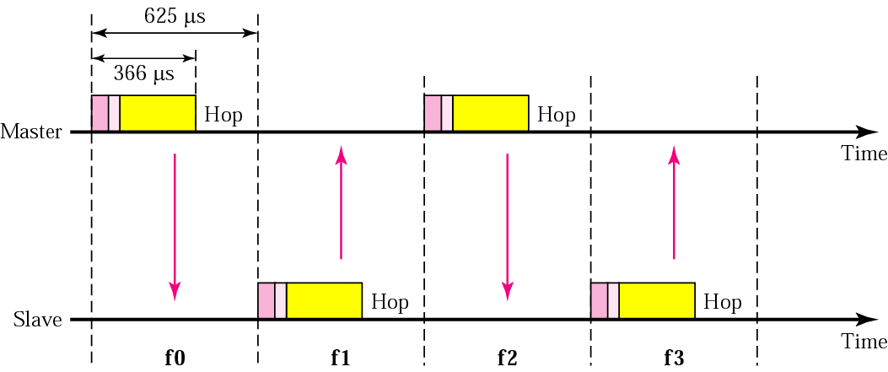
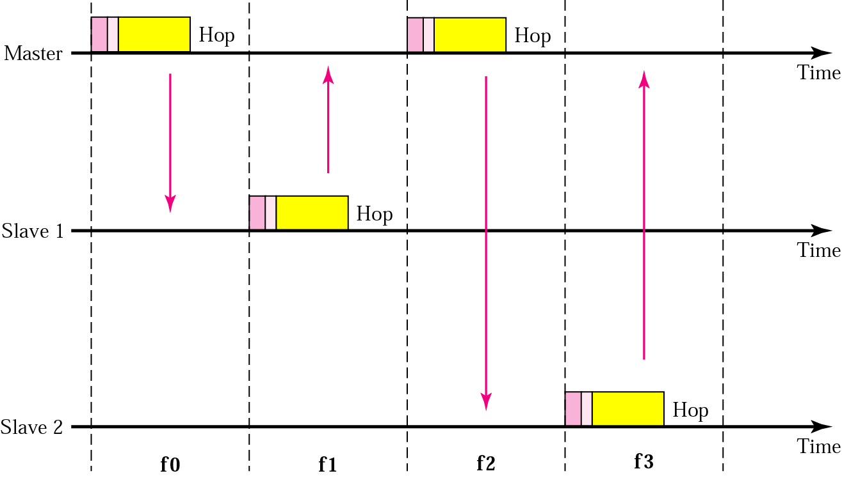
f. Multiple Access Scheme
Single-slave communication
259
Multiple-slave communication

Slide 28
6. The Modulation Scheme
The operating band is divided into 1 MHz-spaced channels, each signaling data at 1 Mega-symbol per second = 1 MB/s.
With the chosen modulation scheme of GFSK with Kf= 0.3.
Binary 1 gives Fc +Δf , while a binary 0 gives Fc -Δf.
After each packet, both Tx & Rx retune their radio to a different frequency, hopping from channel to channel.
Bluetooth devices use the whole of the available band and if a interference occurred on one channel, the retransmission will always be on a different (hopefully clear) channel.
Each Bluetooth time slot lasts 625 μs, and devices hop once per packet: every slot, every 3 slots, or every 5 slots.

Slide 29
7. Medium Access Control
Bluetooth with 79 channels can support 79 Mb/s.
When a Piconet is established, the slaves add offsets to their native clocks to synchronize to the master.
Each unit can become a master or slave. By definition, the unit that establishes the Piconet becomes the master.
Access is completely contention free.
The master implements centralized control;
The time slots are alternately used for master transmission and slave transmission.

Slide 30
8. Voice and Data Links
Bluetooth allows both time sensitive communication: voice or audio, and time insensitive packet: data communication.
So, two different types of links are defined:
Synchronous Connection Oriented (SCO) links
for voice communication
Asynchronous Connectionless (ACL) links
for data communication.
ACL data packets: a 72-bit access code, a 54-bit packet header, a 16-bit CRC code, + the payload data.
Different types of packets allow different amounts of data to be sent: The largest packet data payload is a DH5 (Data High) packet, with 5 slots. A DH5 packet carry 339 bytes, or 2712 bits of data. So, 2858 bits are sent for 2712 bits of information, reply 1 slot = asymmetric link.

Slide 31
Mixing of synchronous SCO links and asynchronous ACL links on a single piconet channel.
SCO ACL SCO ACL ACL SCO
M
S1
S2
S3

Slide 32
9. Communication Scenario

Slide 33
a. Connection Establishment
How to find each other? how do they make connections?
Scan, page, and inquiry support connection establishment:
In idle mode (sniff): the unit periodically listens if other units want to connect. The scan window is about 10 ms.
At every wake up, it scans at a different hop carrier. The Bluetooth
wake up hop sequence is only 32 hops in length and is cyclic. All
32 hops in the wake up sequence are unique, and they scan at least
64 MHz of the 79 MHz available.
Scan duration
10 ms
Sniff offset
Slave
Master
Sniff period

Slide 34
b. Power Management:
Low power mode (hold)
Duty cycle is well below 1 %
Hold offset
Slave
Hold duration
Master

Slide 35
c. Power Management: (Park)
PARK mode can only be applied after the piconet has been established. Duty cycle can be reduced << 1%
126 μs
Slave
Beacon instant
Master
Beacon interval
Power saving + keep more than 7 slaves in a piconet
Give up active member address, maintain synchronization

Slide 36
To make a connection unit broadcasts inquiry message with return address & clock information.
Standby
Standby
ID
Inquiry
Inquiry
FHS
Inquiry
response
Idle units listens the inquiry, returns the inquiry and FHS packet which includes identity & clock information.
During page & inquiry, 32 hop used & access code is used for signaling
Inquiry is the process where a device will attempt to discover all the Bluetooth enabled devices in its local area.
Access cod
Page
Page
Slave ACKs the paging massage, switches to the Master’s CLK & moves to Master’s frequency hop and timing sequence
ID
Master
response
Slave
response
FHS
M enters the M response with its FHS packets.
During connection state, various data exchange & logical channels are possible.
Connection
(M)
Connection
(S)

Slide 37
10. Bluetooth Experiment Goals
    Impact of distance and Bit Error Rate (BER) on throughput.
    Effect of one-to-many connection on throughput.
    Interference among Bluetooth devices.
    Interference and fairness between Bluetooth and IEEE 802.11 devices.

Slide 38
Experiments (1)
    Measure TCP data throughput using Iperf
    measurement tool on one-to-one connection at
    different distance and packet type (DH1, DH3, and
    DH5).
1st Position
2nd Position
3rd Position
Master
Slave
Slave
Slave
5m (16.4 ft)
10m (32.8 ft)
15m (49.2 ft)

Slide 39
Experiments (2)
    Measure TCP data throughput on one-to-two and one-to-four connection.
Slave
Slave
5m (16.4 ft)
5m (16.4 ft)
Master
Master
5m (16.4 ft)
5m (16.4 ft)
5m (16.4 ft)
5m (16.4 ft)
Slave
Slave
Slave
Slave
One-to-two Connection
One-to-four Connection

Slide 40
Experiments (3)
    Measure TCP data throughput in four crossed one-to-one connections.
Master
Master
Slave
Master
5m (16.4 ft)
Slave
Master
Slave
Slave

Slide 41
Experiments (4)
    Measure TCP data throughput for one-to-one connection crossed by IEEE 802.11 transfer.
IEEE 802.11
Master
Slave
IEEE 802.11

Slide 42


Slide 43
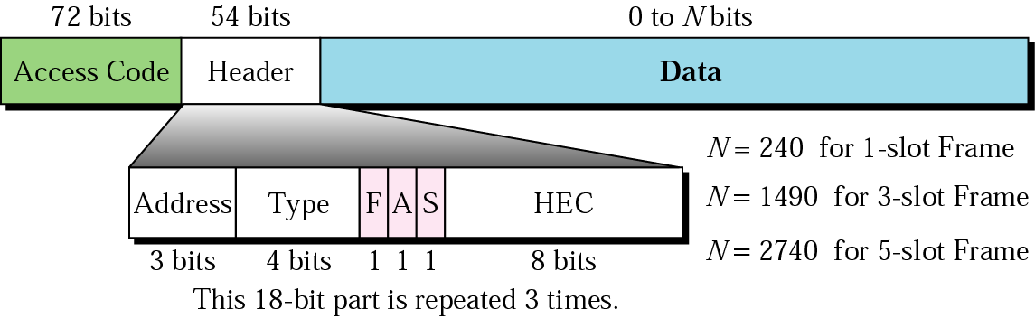
Frame format types
(3 x 18)
The Address - identifies which of the 8 active devices the frame is intended for.
The Type - frame type (ACL, SCO)
The Flow - is asserted by a slave when its buffer is full and cannot receive any more data
The Ack-ment bit is used for ACK
The Sequence - is used to number the frames for retransmissions. The protocol is stop-and-wait.
Checksum The 18-bit header is repeated 3 times for a total of 54 bits Header

Slide 44
11. Materials for HW and the Report

Slide 45
Physical Link Definition
1. SCO link (voice traffic)
2. ACL link (data traffic)
The SCO link is a point-to-point link between the M and a single S. The link is established by reservation of duplex slots at regular intervals. For SCO links only single-slot packets have been defined and supports a full-duplex link with a user rate 64 kbps in both directions.
The ACL link is a point-to-multipoint link between the M and all the slaves on the Piconet. The ACL link can use all of the remaining slots on the channel not used for SCO links. The traffic over the ACL link is scheduled by the M. The maximum user rate is 723.2 kbps. In that case, a return link of 57.6 kbps can be supported.

Slide 46
Data Packet Types (Details for calculations)
Symmetric
Asymmetric
DM1
108.8 | 108.8 | 108.8
258.1 | 387.2 | 54.4
286.7 | 477.8 | 36.3
DM3
2/3 FEC
DM5
Symmetric
Asymmetric
No FEC
DH1
172.8 | 172.8 | 172.8
390.4 | 585.6 | 86.4
433.9 | 723.2 | 57.6
DH3
DH5
DM-Data Medium, with Forward Error Control
DH-Data High, no Forward Error Control

Slide 47
Identifies the master and slaves within radio range of two masters can tell which traffic is for them.
Packet Format
For a single time slot the data field is 240 bits.
72 bits
54 bits
0 - 2744 bits
Access
code
Header
Payload
Containing typical MAC sublayer fields
Voice
header
Data
CRC
No CRC
No retries
ARQ
FEC Forward error coding (optional)
FEC (optional)
625 µs
master
slave

Slide 48
Access Code
72 bits
Access
code
Header
Payload
Purpose
Types
Synchronization
DC offset compensation
Identification
Signaling
Channel Access Code (CAC)
Device Access Code (DAC)
Inquiry Access Code (IAC)
X

Slide 49
Packet Header
54 bits
m
Access
code
Header
Payload
s
s
Purpose
s
Addressing (3)
Packet type (4)
Flow control (1)
1-bit ARQ (1)
Sequencing (1)
HEC (8)
Max 7 active slaves
16 packet types (some unused)
Broadcast packets are not ACKed
For filtering retransmitted packets
Verify header integrity (Header Error Control)
total
18 bits
Encode with 1/3 FEC (Forward Error Correction) to get 54 bits

Slide 50
Voice Packets (HV1, HV2, HV3)
HV-High Voice
72 bits
54 bits
240 bits
= 366 bits
Access
code
Header
30 bytes
Payload
HV1
10 bytes
+ 1/3 FEC
HV2
20 bytes
+ 2/3 FEC
HV3
30 bytes
3.75ms (HV3)
2.5ms (HV2)
1.25ms (HV1)

Slide 51
Multi slot packets
FH/TDD
f1
f4
f5
f6
m
s1
s2
625 µsec
Data rate depends on type of packet

Slide 52
The frequency and timing characteristics of: single-slot, three-slot and five-slot packets
0.625 msec
f(k)
f(k+1)
f(k+2)
f(k+3)
f(k+4)
f(k+5)
TX
RX
TX
RX
TX
RX
f(k)
f(k+3)
f(k+4)
f(k+5)
TX
RX
TX
RX
f(k)
f(k+5)
TX
RX

Slide 53
Data rate calculation: DM1 and DH1
625 µs
72 bits
54 bits
240 bits
= 366 bits
Access
code
30 bytes
Header
Dir | Size | Freq | Rate
↑ | 17 | 1600/2 | 108.8
↓ | 17 |  | 108.8
↑ | 27 |  | 172.8
↓ | 27 |  | 172.8
Payload
DM1
1
17
2/3
FEC
2
DH1
1
27
2
625 µs
1
2

Slide 54
Data rate calculation: DM3 and DH3
1875 µs
72
bits
54
bits
1500 bits
= 1626 bits
Access
code
Header
187 bytes
Dir | Size | Freq | Rate
↑ | 121 | 1600/4 | 387.2
↓ | 17 |  | 54.4
↑ | 183 |  | 585.6
↓ | 27 |  | 86.4
Payload
DM3
2
121
2
2/3
FEC
DH3
2
183
2
1875 µs
1
2
3
4

Slide 55
Data rate calculation: DM5 and DH5
3125 µs
72
bits
54
bits
= 2870 bits
2744 bits
Access
Code
343 bytes
Header
Payload
Dir | Size | Freq | Rate
↑ | 224 | 1600/6 | 477.8
↓ | 17 |  | 36.3
↑ | 339 |  | 723.2
↓ | 27 |  | 57.6
DM5
2
224
2
2/3
FEC
DH5
2
339
2
3125 µs
625 µs
1
2
3
4
5
6

Slide 56






Appendix. ZigBee and Bluetooth
Z-B
B-T
Optimized for different applications
ZigBee 802.15.4
  Smaller packets over large network
  Mostly Static networks with many, infrequently used devices
  Home automation, toys, remote controls, etc.
Bluetooth 802.15
  Larger packets over small network
  Ad-hoc networks
  File transfer
  Screen graphics, pictures, hands-free audio, Mobile phones, headsets, PDAs, etc.

Slide 57
Transceiver Comparisons
Z-B
Instantaneous Power Consumption
  15.4 Transceivers are “similar” to Bluetooth Transceivers
    802.15.4
      O-QPSK with shaping (Offset QPSK)
      Max data rate 250 kbps over the air
      2 M.chips/s over the Direct Sequence Spread Spectrum (62.5ksps*32 spread)
      -90 dBm sensitivity
    Bluetooth 802.15
      FSK
      Max data rate 720 kbps over the air
      1 Msps over the Frequency Hop Spread Spectrum (79 channels @ 1600 hps)
      -85dBm sensitivity
Instantaneous power consumption will be similar for the raw transceivers without protocol
Bluetooth’s frequency hop makes it extremely difficult to create extended networks without large synchronization cost

Slide 58


ZigBee and Bluetooth (cont)
Z-B
Air interface
ZigBee
DSSS- 11 chips/ symbol
62.5 K symbols/s
4 Bits/ symbol
Peak Information Rate
~128 Kbit/second
Bluetooth
FHSS
1 M Symbol / second
Peak Information Rate
~720 Kbit / second

Slide 59
ZigBee and Bluetooth (cont)
Z-B
Timing Considerations
ZigBee:
Network join time = 30ms typically
Sleeping slave changing to active = 15ms
Active slave channel access time = 15ms
Bluetooth:
Network join time = >3s
Sleeping slave changing to active = 3s typically
Active slave channel access time = 2ms typically

Slide 60
Light switch using ZigBee
With DSSS interface, only need to perform CSMA before transmitting
  Only 200 µs of latency
  Highly efficient use of battery power
Z-B
ZigBee offers longer battery life and lower latency than a Bluetooth equivalent.

Slide 61
Bluetooth protocol stack
Application layer
Applications
Middleware layer
IP
SDP
RFCOMM
Data
HCI
Data link layer
Audio
L2CAP
Link Manager
Single chip with
RS-232,USB, or
PC card interface
Baseband
Physical layer
RF
Allocations of The Bluetooth protocol stack is a series of layers, through there are some features which cross several layers.

Slide 62
The Bluetooth Protocol Architecture
Application
layer
Middleware
layer
Data link
layer
Physical
layer
Application/Profiles
Audio
Other RFcomm Telephony Service
cont. pr. discovery
Host
Control
LLC
Logical link control adaptation protocol
(L2CAP)
(LLC)
Link manager
Baseband (MAC)
Physical radio
1. The Physical Layer is responsible for: electrical interface media, modulation & channel coding. It covers the radio and part of baseband and corresponds to the physical layer in the OSI and 802 models.
2. The Baseband Layer is analogous to the MAC sublayer + elements of the physical layer. It deals with how the master controls time slots and how these slots are grouped into frames.
3. L2CAP: analogous to the standard 802 LLC sublayer, but different.

Slide 63
The Bluetooth Protocols
Application
layer
Middleware
layer
Data link
layer
Physical
layer
Application/Profiles
Audio
Other RFcomm Telephony Service
cont. pr. discovery
Host
Control
LLC
Logical link control adaptation protocol
Link manager
Baseband
Physical radio
a. Telephony (TCS Telephony Control Protocol Specification) provides telephony services. Bluetooth’s TCS defines how telephone calls should be sent across a Bluetooth link. It gives guidelines for the signaling needed to set up both point-to-point, and point-to-multipoint calls.
b. SDP (Service Discovery Protocol) lets Bluetooth devices to discover what services other Bluetooth devices support. In LAN, you find a connection to a printer, and once found, it stays in place. Bluetooth is designed to allow to walk into an area and find a printer, without having to pre-configure settings.

Slide 64
The Bluetooth Protocols (Cont)
Application
layer
Middleware
layer
Data link
layer
Physical
layer
Application/Profiles
Audio
Other RFcomm Telephony Service
cont. pr. discovery
Host
Control
LLC
Logical link control adaptation protocol
Link manager
Baseband
Physical radio
c. RFCOMM is protocol for RS-232 serial cable. RS-232 serial ports have nine circuits, which can be used for transforming data and signaling. It provides multiple concurrent connections by relying on L2CAP to handle multiplexing over single connections, and to provide connections to multiple devices.
d. L2CAP (Logical Link Control and Adaptation Protocol). This provides segmentation and re-assembly services to allow large packets to pass across Bluetooth links, also takes data from higher layer of the Bluetooth stack and from applications and sends it over the lower layers of the stack.

